Slide 1

B.SC DIGITAL AND CYBER FORENSIC SCIENCE
TITLE: EMBEDDED REVERSE ENGINEERING OF WIPER MALWARE
NAME
: JOHN BOSCO ANTONY X
REGISTER NUMBER
: 2128A0021
CAPSTONE PROJECT
: SEMESTER V
UNDER THE GUIDANCE OF
: Mr. A . KAMALRAJ M.C.A.,(Ph.D).,
HEAD OF THE DEPARTMENT
: Mr. A . KAMALRAJ M.C.A.,(Ph.D).,

Slide 2
CONTENTS
S.NO | TITLE | PAGE No
 | SYNOPSIS
1 | INTRODUCTION
 | 1.1 About the Project
2 | SYSTEM STUDY AND ANALYSIS
 | 2.1 Proposed System
 | 2.1.1 Advantages of the Proposed System
3 | SYSTEM CONFIGURATION
 | 3.1 Hardware Configuration
 | 3.2 Software Configuration
 | 3.2.1. Dynamic Analysis tool
 | 3.2.2. Operating system
4 | SYSTEM TESTING AND IMPLEMENTATION
5 | CONCLUSION
6 | FURTHER SCOPE OF THE PROJECT
7 | BIBILIOGRAPHY
8 | APPENDIX
 | 8.1 Project Design

Slide 3
SYNOPSIS

Slide 4
SYNOPSIS
The objective of the project is “EMBEDDED REVERSE ENGINEERING OF WIPER MALWARE”. It is the process of analyzing and understanding destructive wiper malware specifically designed to target embedded systems.
The aim of project is done using ghidra tool to detect the wiper malware and the operating system is KALI LINUX 5.14.0.
The proposed system of the project is to Embedded Reverse Engineering of Wiper Malware involves a comprehensive and systematic approach to analyze, understand, and defend against destructive wiper malware specifically designed to target embedded systems.
This project consists of five modules:
Module 1 - Initial Setup and Environment Configuration: Set up the necessary hardware and software environment for malware analysis, such as a controlled isolated environment.
Module 2 - Malware Sample Collection and Preparation: Obtain a clean copy of the wiper malware sample for analysis.
Module 3 - Static Analysis: Use Ghidra to load the malware binary and perform static analysis.
Module 4 -Dynamic Analysis: Execute the malware in a controlled environment to observe its behavior and interactions with the system.
Module 5 - Behavioral Analysis: Analyze the dynamic analysis logs and captured network traffic by the malware that lead to data destruction or system compromise.

Slide 5
INTRODUCTION

Slide 6
1. INTRODUCTION
The project entitled as “EMBEDDED REVERSE ENGINEERING OF WIPER MALWARE”. It is the process of analyzing and understanding destructive wiper malware specifically designed to target embedded systems.
Malicious programs or malicious software are designed intentionally to cause damage to the targeted system. Reverse Engineering a malware helps to find how a malware work and what are the steps needed to be taken to terminate the malware program.
1.1 ABOUT THE PROJECT
Malware Reverse Engineering is a part of malware analysis. The modules of the malware reverse engineering involve:
Static Malware Analysis
Dynamic Malware Analysis
Static Malware Analysis module
This module involves tools and techniques that are concerned in the process of static malware analysis. This process engages the tool VirusTotal. It is the process of analyzing the malware without running them. It gives various details like metadata, malicious functions used to create the malicious software, etc.
Dynamic Malware Analysis module
This module engages the processes and the tool involved in Dynamic malware analysis. The tool used in this process is Ghidra. It is a process in which the malware is analyzed and further details about the malware and the functionalities of the malware is obtained.

Slide 7
SYSTEM STUDY AND
ANALYSIS

Slide 8
2.SYSTEM STUDY AND ANALYSIS
PROPOSED SYSTEM:
The proposed system for the project titled “Embedded Reverse Engineering of Wiper Malware” involves the development of a comprehensive framework for the analysis and mitigation of wiper malware in embedded systems. The system aims to employ advanced reverse engineering techniques to dissect the intricate workings of such malware within the context of embedded devices.
The methodology will include the utilization of specialized tools designed for embedded systems security and malware analysis. The proposed system will prioritize the identification of unique features and behavioral patterns exhibited by wiper malware in embedded environments.
Advantages of proposed system : Better Protection:
It helps us understand and defend embedded systems (like smart devices) from harmful wiper malware, making them more secure.
Customized Defense:
By studying specific cases, we can create defenses tailored to the unique tricks of the malware, making our protection more effective.
Stopping Problems Early:
We can catch malware before it causes big problems, preventing damage to our devices.
Reacting Faster:
If there is an issue, the system helps us respond quickly and effectively to minimize any harm.
Learning and Sharing:
It’s a great way for people in cybersecurity to learn new skills and share knowledge with each other.

Slide 9
SYSTEM CONFIGURATION

Slide 10

3.SYSTEM CONFIGURATION
3.1 HARDWARE CONFIGURATION
3.1. Model: Dell optiplex 5490 All in one
Processor: Intel core i5 – 11500
Chipset: Intel Q570
Memory: 16GBDDR4
Network: Integrated realtek Ethernet LAN 10/100/1000
Intel WI-FI 6 AX201+Bluetooth 5.1
Hard Drive: 512GB NVMe class 35 SSD
Chassis: AIO – 13.54”*21.26”*2.07”
Display: “23.8” FHD Non-Touch Anti-Glare
Keyboard: Dell KB216 Wired Multimedia USB Keyboard  Mouse: Dell MS116 optical Mouse .
3.2. SOFTWARE CONFIGURATION
Dynamic Analysis tool: Ghidra
Operating System: Kali Linux Operating System
3.2.1.
Dynamic Analysis tool: Ghidra

Slide 11

Version: 10.1.3 Size: 2.98KB
Type: Application
Ghidra is a Reverse Engineering tool developed by NSA and released as an open-source tool. It’s full of capabilities that include disassembly, assembly, and decompilation. It is crossplatform and handles programs compiled for Windows, Linux, and Mac. A major advantage is that the tool decompiles the object back to the source code.
3.2.2. Operating System: Kali LinuxOperating system
OS family | Linux
Source model | open-source
Initial release | 13 march 2013
Latest release | 23 August 2023
Platforms | x86, x86-64, armel, armhf
Kernel type | Monolithic
Official website | https:www.kali.org/

Slide 12
SYSTEM TESTING AND
IMPLEMENTATION

Slide 13
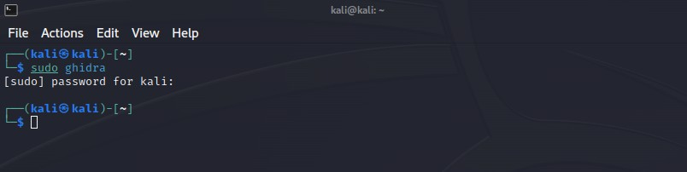
4.SYSTEM TESTING AND IMPLEMENTATION
Dynamic malware analysis using Ghidra:
Ghidra is a disassembler developed by NSA and released as an open-source tool in 2019. Dynamic malware analysis in Ghidra involves observing and analyzing the behavior of a malware sample in real-time, typically through execution in a controlled environment, to understand its runtime activities, interactions with the system, and potential malicious actions.
Step 1:
Launch the terminal on your Linux system. You can usually find it in your applications menu or use a keyboard shortcut like Ctrl + Alt + T.
Open the terminal and give the command “sudo ghidra” to open the Ghidra.
The sudo command elevates your privileges to execute the ghidra run script with administrative rights.
If everything is set up correctly, Ghidra’s graphical user interface (GUI) should open, allowing you to start your reverse engineering work.
Fig4.1: Open terminal in kali linux

Slide 14
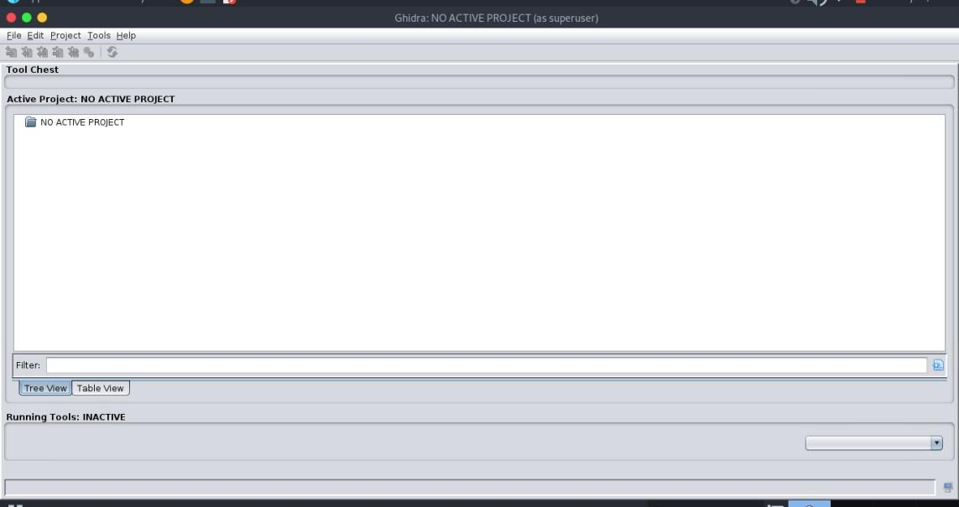
Step 2:
The workspace of the Ghidra is opened. Ghidra typically starts by asking you to create or open a project. A project in Ghidra is like a container for all your analysis work. It stores information about the binaries you analyze, your comments, and more.
Fig4.2: The workspace of the Ghidra is opened.
Step 3:
Now click File >> New Project >> select “non-shared project” >> and click “Next”. From the dropdown menu that appears when you click on “File,” choose “New Project.”

Slide 15
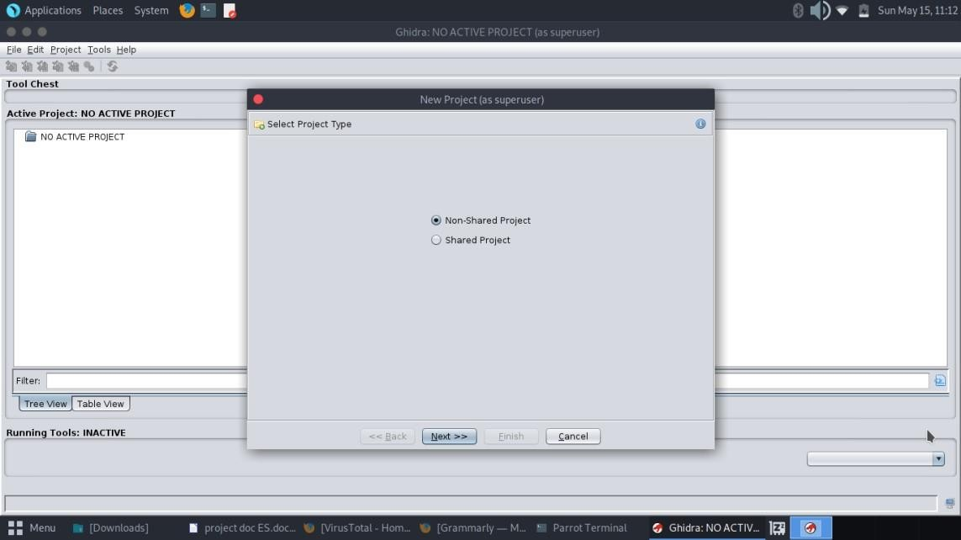
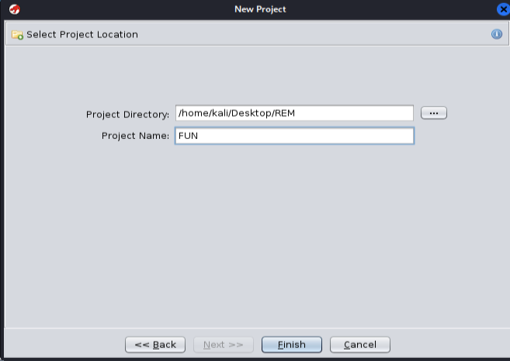
Fig4.3: Create a new project in ghidra.
Step 4:
In this step, Ghidra will prompt you to specify the location where you want to save your project and provide a name for your project. Click on the “Browse” button to choose the location.
Fig4.4: Create a name for the project
New project is created. After completing the creation process, Ghidra displays a confirmation message indicating that your project has been created successfully. You can click “OK” to acknowledge this message.

Slide 16
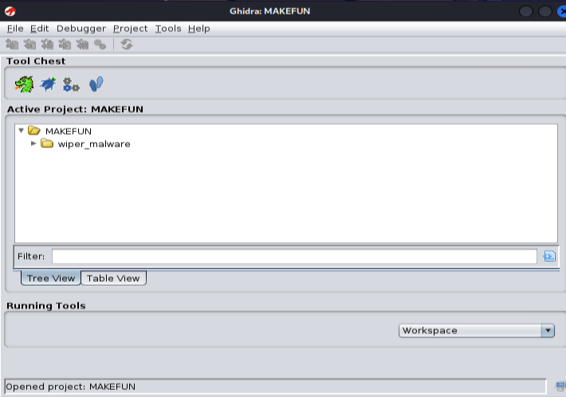
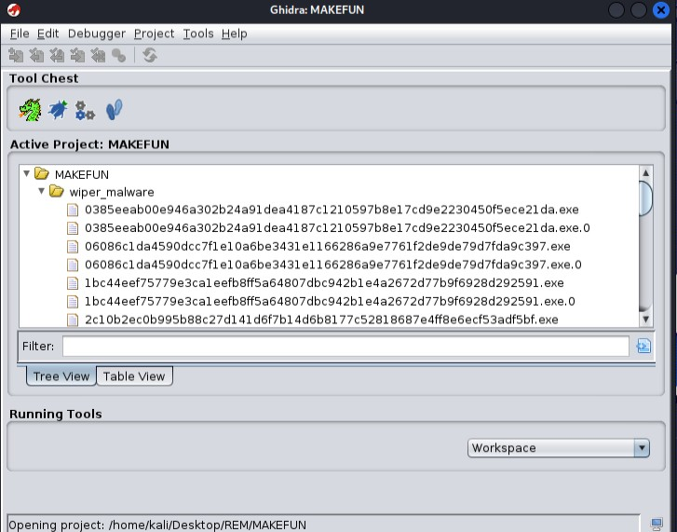
Fig4.5: Drag the file for the analysis.
Now drag and drop the file that is needed to be analyzed. Click “OK” to proceed with analysis. Take the file you want to analyze and drag it into the main Ghidra window. You can drop it in the “Project Window” or the “CodeBrowser” area.
Ghidra will prompt you to select the processor for the file. This is important because different processors have different instruction sets. Choose the appropriate processor for the binary you are analyzing.
Fig4.6: These are the listed files in wiper malware.
Step 5:

Slide 17
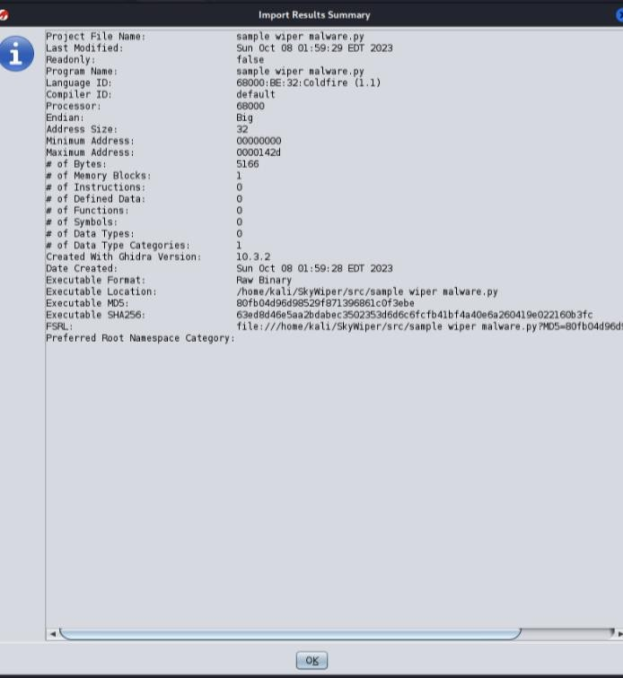
After importing the executable file, the Ghidra shows the IMPORT SUMMARY. Now click “OK” to proceed. The IMPORT SUMMARY typically includes information such as the number of functions detected, external libraries used, and any noteworthy characteristics of the binary. This summary serves as a quick reference point for understanding the nature of the imported file.
Fig4.7: The Ghidra shows the IMPORT SUMMARY
Now, in the workspace, the imported malware sample can be viewed. This step allows you to familiarize yourself with the initial findings of Ghidra’s analysis and provides a foundation for your subsequent reverse engineering activities.

Slide 18
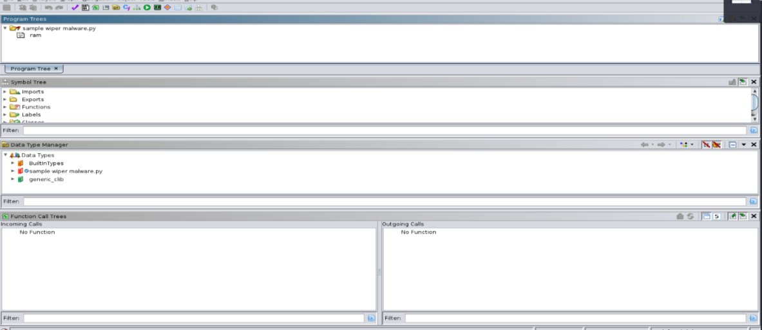
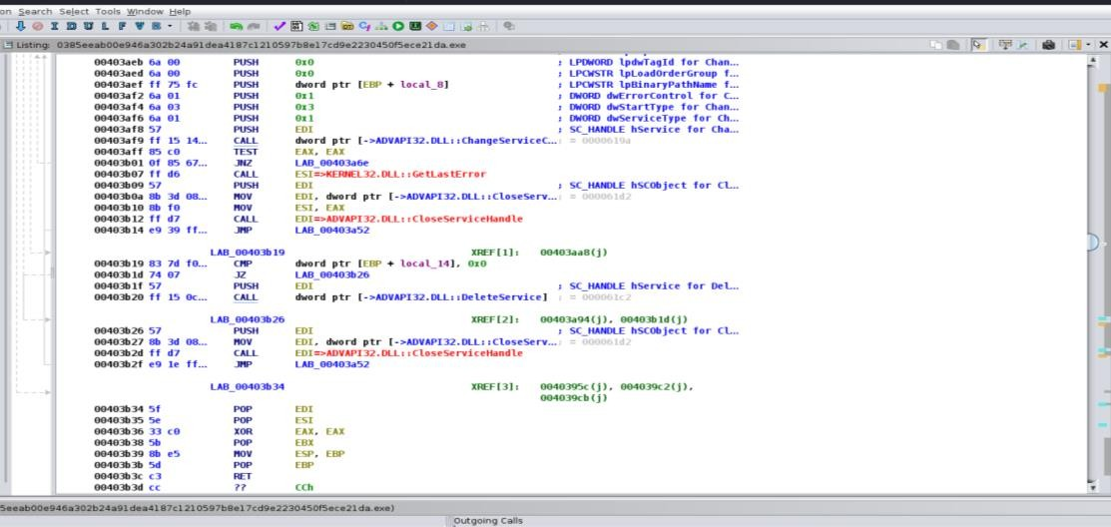
Step 6:
Click the CodeBrowser tool on the tool Chest. This opens the CodeBrowser tool. Click FILE menu and select “OPEN”. Select the imported malicious file and click “OK”.
Fig4.8: This opens the CodeBrowser tool
Step 7:
The CodeBrowser asks permission to analze the selected file. Click “Yes”. With the initial analysis completed, you can now continue exploring the disassembled code, identifying functions, and gaining insights into the behavior of the executable.
Fig4.9: These are the listing files of the project.

Slide 19
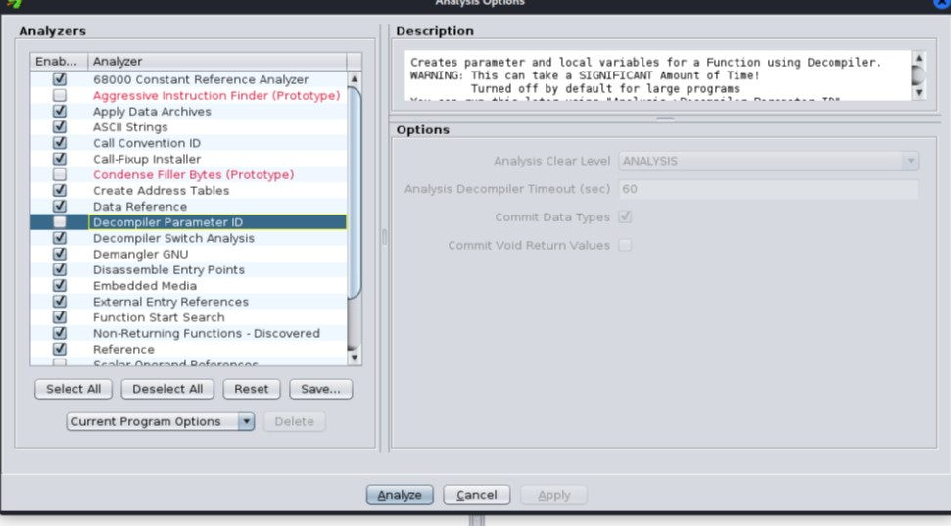
Step 8:
The CodeBrowser show the analysis option. Select the “WindowsPE x86 Propagate External Parameters” and click “Analyze” to proceed with analysis. With the initial analysis completed, you can now continue exploring the disassembled code, identifying functions, and gaining insights into the behavior of the executable.
Fig4.10: The CodeBrowser show the analysis option.

Slide 20
CONCLUSION

Slide 21
5. CONCLUSION
The project entitled as “EMBEDDED REVERSE ENGINEERING OF WIPER MALWARE”. It is the process of analyzing and understanding destructive wiper malware specifically designed to target embedded systems. Malicious programs or malicious software are designed intentionally to cause damage to the targeted system. Reverse Engineering a malware helps to find how a malware work and what are the steps needed to be taken to terminate the malware program.
The project not only deepened our understanding of these threats but also presented insights into strategies for enhancing security measures. By identifying unique features and employing advanced reverse engineering techniques, we have contributed valuable knowledge that can be applied to fortify embedded systems against wiper malware attacks.

Slide 22
FURTHER SCOPE OF THE
PROJECT

Slide 23
6. FURTHER SCOPE OF THE PROJECT
The future scope of a project titled “Embedded Reverse Engineering of Wiper Malware” could be quite significant, given the evolving landscape of cybersecurity threats and the increasing sophistication of malicious actors. Here are some potential areas of future development and relevance:
Advanced Threat Detection and Mitigation:
As malware continues to evolve, there will be a continuous need for advanced threat detection mechanisms.
Security Research and Intelligence:
Ongoing research in embedded reverse engineering could contribute to a better understanding of malware techniques and help build more robust security intelligence.
Embedded System Security:
The security of embedded systems is crucial in various domains, including IoT (Internet of Things) devices, industrial control systems, and critical infrastructure.
Your project could have implications for enhancing the security of embedded systems, which are increasingly becoming targets for cyber attacks.
Incident Response and Forensics:
Cybersecurity incident response teams can benefit from insights gained through the reverse engineering of malware. Your project may contribute to developing better forensic tools and methodologies.
Threat Intelligence Sharing:
Sharing threat intelligence is crucial for a collaborative and proactive approach to cybersecurity.
Your project could lead to insights that contribute to threat intelligence sharing communities.

Slide 24
Adaptive Security Measures:
As malware becomes more adaptive and polymorphic, security measures must also evolve. Your research could inspire the development of adaptive security measures that can respond to changing threat landscapes.
Education and Training:
The knowledge and tools developed in your project could be valuable for educating and training cybersecurity professionals. This is crucial for building a skilled workforce capable of addressing emerging threats.

Slide 25
APPENDIX

Slide 26
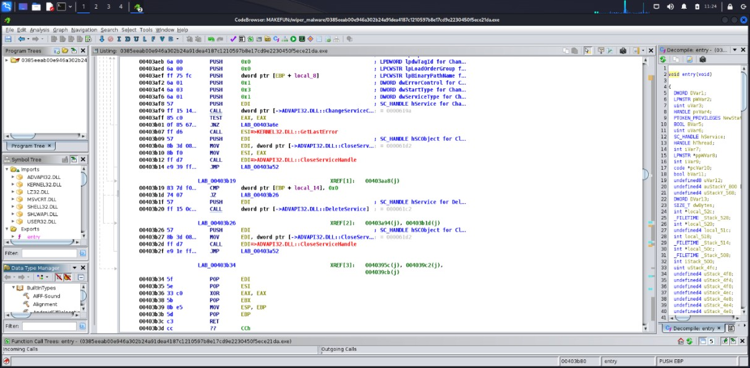
8. APPENDIX
8.1 PROJECT DESIGN
REVERSE ENGINEERING OF WIPER MALWARE USING GHIDRA:
Fig8.1: These are the listed files in wiper malware.
LISTING:
In Ghidra, the term "listing" refers to the primary view within the CodeBrowser where the disassembled code of a program is displayed. The listing provides a detailed and organized presentation of the assembly instructions of the binary being analyzed.
SYMBOL TREE:
The ‘Symbol tree’ contains all the functions that have been used by the malware author. The symbol tree section contains – imports, exports, functions, labels, classes, and namespaces that the malware is using to perform the malicious activities.

Slide 27
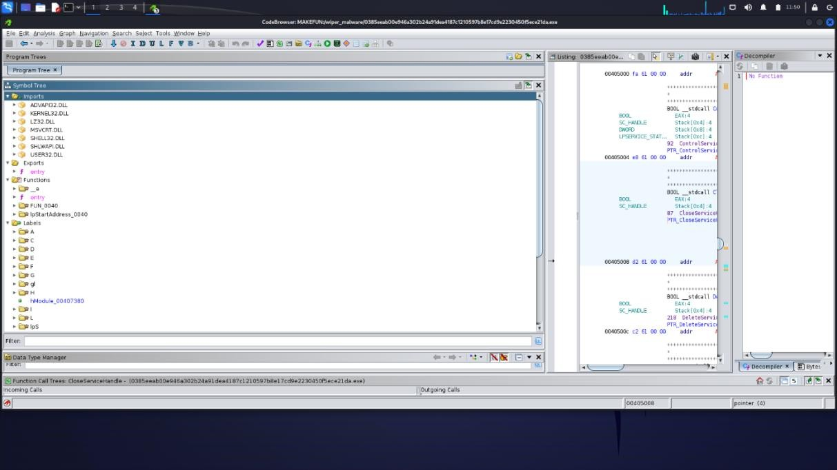
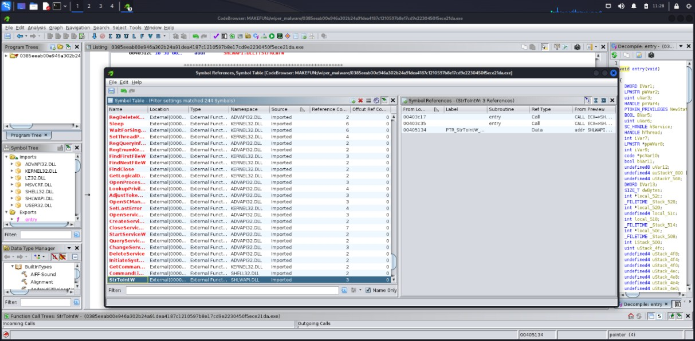
Fig8.2: The symbol tree of the sample wiper malware.
SYMBOL REFERENCE:
In Ghidra, a "Symbol Reference" is a crucial aspect of the analysis, providing insight into the relationships between different parts of the code. Symbols can include functions, variables, labels, and other named entities within the program.
Fig8.3: The symbol reference for the wiper malware.

Slide 28
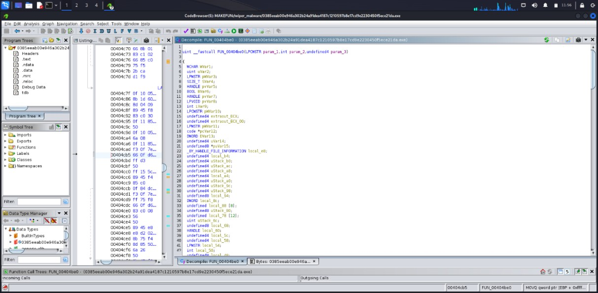
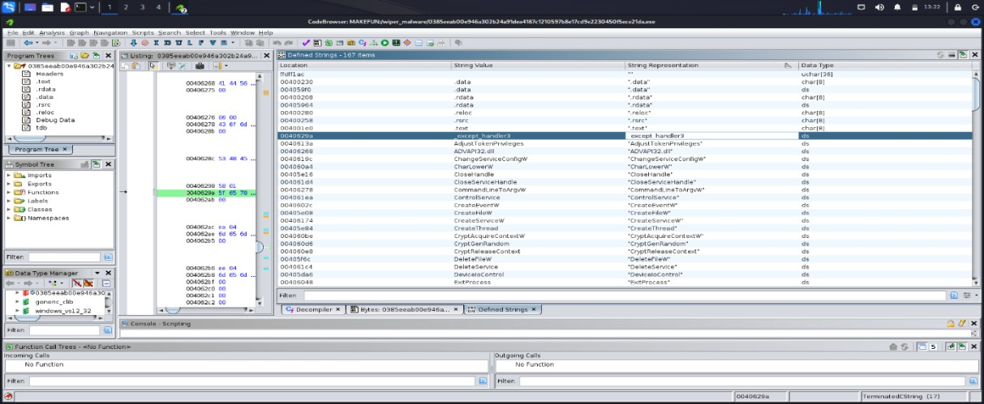
DECOMPILER:
The decompiler translates machine code or assembly instructions into a higher-level programming language, providing a more human-readable representation of the code's logic and functionality.
Fig8.4: The decompiler of the sample file.
In the above figure, the assembly code has attemped to be converted into the C Programming code by Ghidra and is been showed in the ‘Decompile Window’.
By clicking the ‘Display Function Graph Icon’, the ghidra will assist with analyzing the malware using function graph.
DEFINED STRINGS:
Fig8.5: The defined strings of the sample malware.

Slide 29
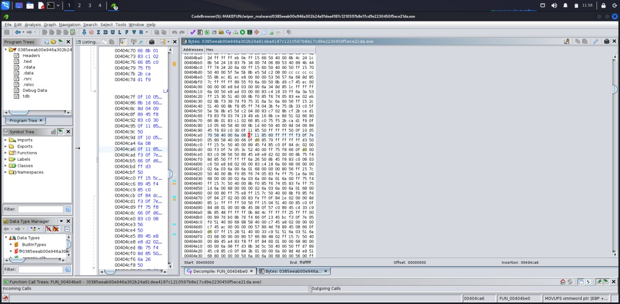
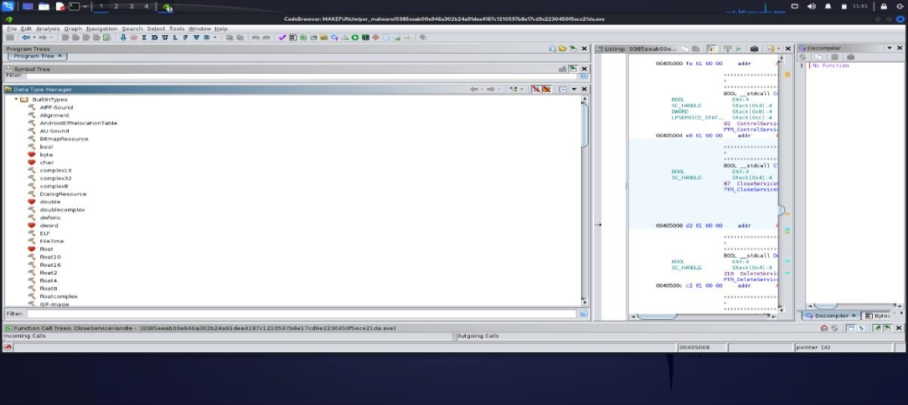
When Ghidra analyzes a binary, it attempts to recognize and label various data structures, functions, and strings within the code.
BYTES:
When analyzing a program in Ghidra, you might inspect the disassembled instructions at the byte level. This can be important for understanding the low-level details of the program's
behavior.
Fig8.6: The bytes value for the sample file.
DATA TYPE MANAGER:
Fig8.7: These are the data manager in the file.

Slide 30
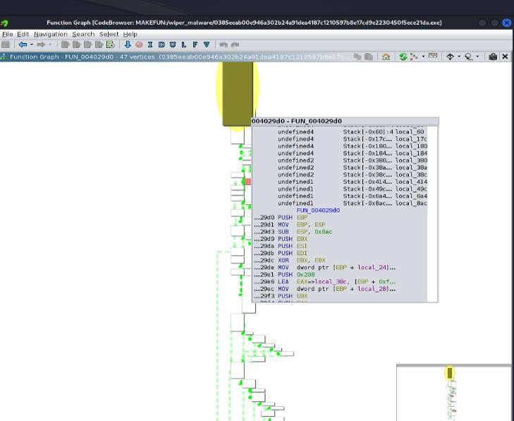
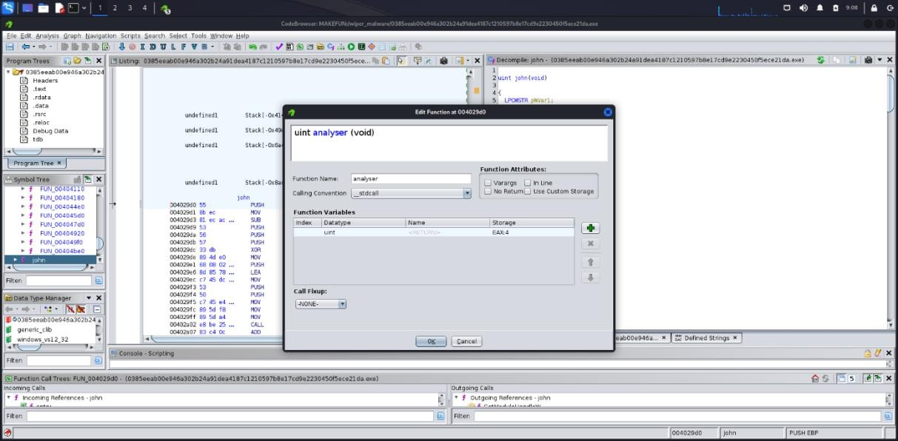
The Data Type Manager (DTM) in Ghidra is a feature that allows you to define and manage custom data types for use in the disassembly and analysis of binary programs
FUNCTION GRAPH:
Fig8.8: The function graph of the malware.
The Function Graph is a visual representation of the control flow within a function in a disassembled binary. It helps you understand the structure and logic of a function by displaying the relationships between different blocks of code and the flow of execution.
EDIT FUNCTION:
Fig8.9: Edit function for the sample malware.
Change the name of the function in the FUNCTION NAME bar.

